Slide 1

Introduction to Polymer:
A framework for Building Web Components
By
Redouan Machouahi
&
Jelmer Pijnappel

Slide 2
What is Polymer?
Front end open-source JavaScript library
Used for building custom Web-Components
Developed by Google (since 2013, first release in 2015)
Some websites that are using polymer:
Youtube
ING
Google Earth
Netflix
McDonald’s
Coca Cola

Slide 3
Why use Polymer?
Promotes the use of the original framework/platform of the web: the browser.
Extends the capabilities of the platform with the sole purpose of making reusable web components, without too complex functions.
Once the browsers have matured enough, Polymer will be of no use. But Polymer opened the use of the standard API before it becomes cool.
Some features:
Simplified way of creating custom elements
Both One-way and Two-way data binding
Computed properties
Conditional and repeat templates

Slide 4
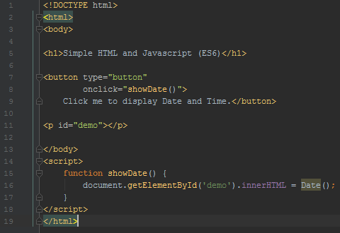
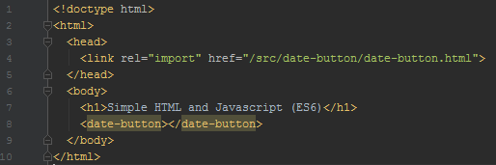
How does Polymer work?
Pure Javascript:
Polymer:
The “date-button” component can be re-used anywhere
HTML, Javascript and CSS are be encapsulated within component, so it will look and function the same everywhere

Slide 5
Polymer workshop
Polymer 2.0 (Polymer 3.0 has just been released)
Contact list application (https://github.com/rmacho/polymer-workshop)
Handy links (Not necessarily needed for this course):
Awesome Polymer: https://github.com/Granze/awesome-polymer
Handling events in Polymer: https://alligator.io/polymer/handling-events/
Polymer 2 cheatsheet: https://meowni.ca/posts/polymer-2-cheatsheet/
Web components library: https://www.webcomponents.org

